Slide 1

Stage 5 Index Check Course Designer: Marcel Englmaier
Index Check is a 32 round, 160 point VIRGINIA count standards exercise. There are 31 paper targets and a single Clay. The best one hit per target will score. Clay must be shot to score. The start signal is audible.
The Handgun start position is standing outside the shooting area with heels touching marks. Handgun is loaded and holstered with wrists below belt.
On the audible start signal, engage targets from within the shooting area with ONE round each. This is a handgun-only stage.

Slide 2
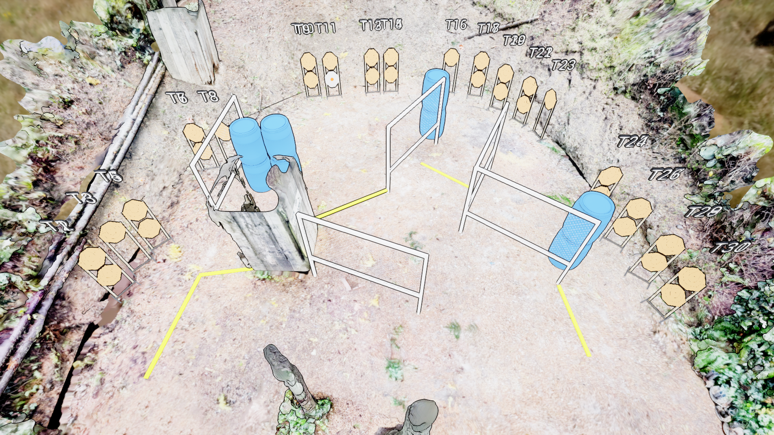
 | Stage 5 Index Check Course Designer: Marcel Englmaier
XX

